Slide 1
AI LLMs Stock Research Report
https://bangbangday.com/zh/report-gen/
XtraFin

Slide 2
Limitations of Manual Stock Research Report
1. Cost and Barrier Issues
a) High Costs: Compiling stock research reports requires a significant investment of time and manpower, making the costs relatively high.
b) Professional Barriers: Producing stock research reports requires certain professional knowledge and background, placing higher demands on the authors.
2. Content Issues
a) Incomplete Data: The data sources reviewed are limited and lack comprehensiveness.
b) Subjectivity Influence: Stock research reports may include the author's personal preferences and viewpoints, thus affecting the objectivity of the report.
3. Usability Issues
a) Poor Timeliness: Stock research reports are difficult to update in real-time, potentially failing to immediately reflect the latest information or data changes.
b) Difficult to Understand: The professional terminology and complex data analyses used in stock research reports may be difficult for non-professional readers to understand.

Slide 3
AI LLMs Stock Research Report Diagram
Fundamentals
Technicals
News
Price Trends
Analyst Predictions
Financial Reports
Technical Indicators
Organization Ratings
Relative Reserach Reports
Market Sentiments
Financial Statements
AI LLMs Analysis
Valuation Analysis
Latest News
AI LLMs Stock Research Report

Slide 4
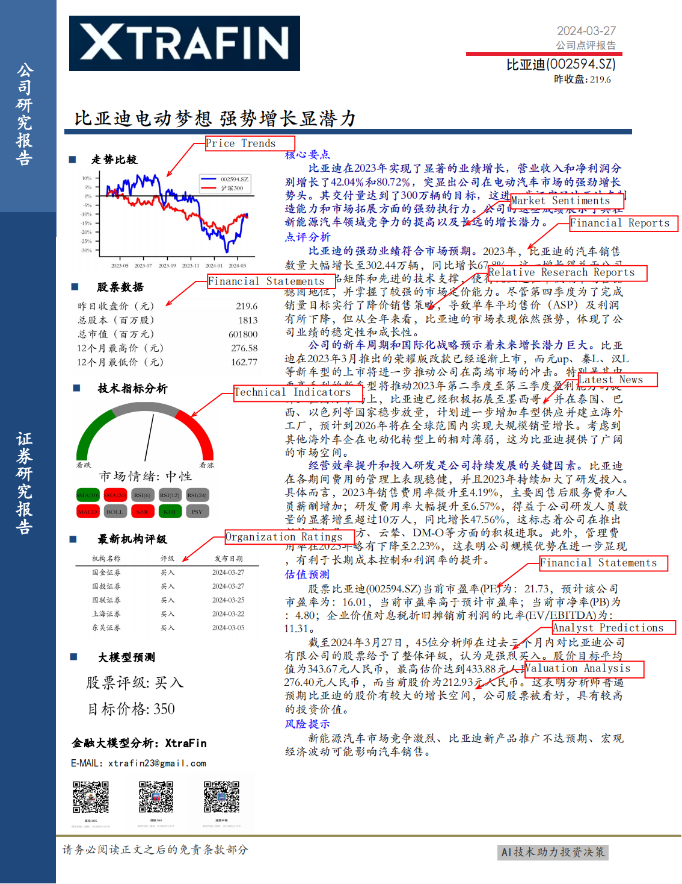
AI LLMs Stock Research Report Sample

Slide 5
The Core Advantages of AI LLMs Stock Research Report
1. Comprehensive Information Sources
Integrates over 20 authoritative financial information sources to ensure data comprehensiveness.
2. Strong Timeliness
Utilizes the latest news, allowing for the rapid generation of detailed stock research reports in just 5 minutes.
3. The unique value of AI LLMs
a) Objectivity
b) Easy to Understand
c) Covers more than 4,000 A-shares
d) Efficient and Cost-effective
e) Broad Audience

Slide 6







Comprehensive Information Sources (integrated over 20 authoritative financial information sources)
Yahoo Finance
Alpha Vantage
EastMoney
Moomoo
10jqka
finance.sina
Google news
......

Slide 7
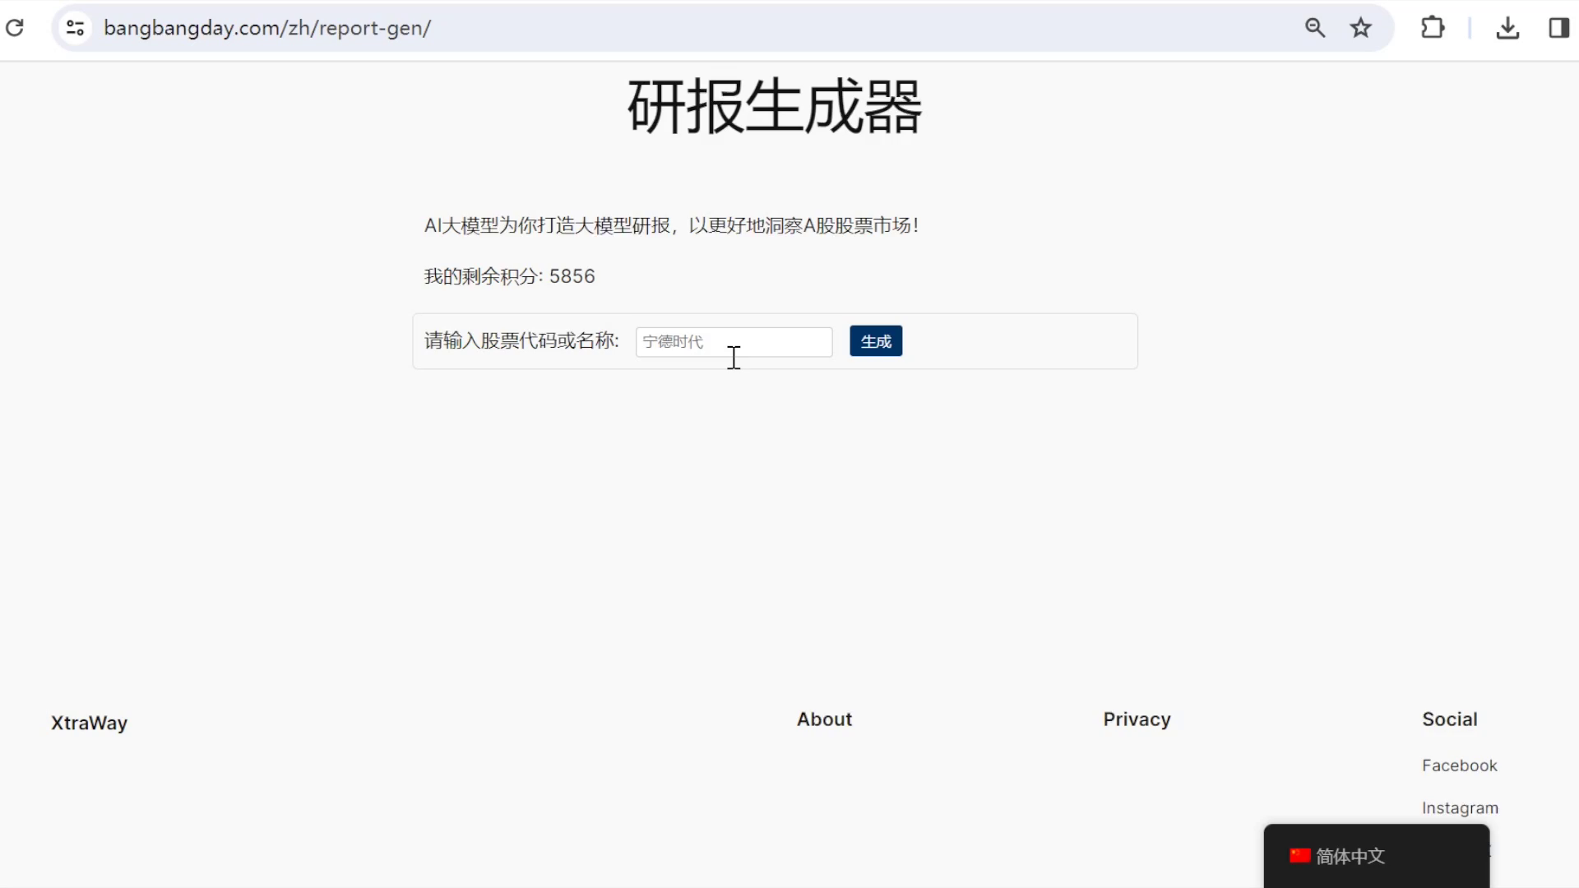
Strong Timeliness (utilized the latest information, generation took only 5 minutes)

Slide 8
The Unique Value of AI LLMs
Objectivity: Eliminates human biases, ensuring the objectivity and fairness of stock research reports.
Easy to Understand: Presents complex data in an easy-to-understand manner, expanding the audience base.
Extensive Coverage: Comprehensively cover over 4,000 A-share stocks, supporting the generation of highly customized stock research reports.
Efficient and Cost-effective: Achieves rapid and large-scale production of stock research reports at a lower cost, significantly improving efficiency.
Broad Audience
Large Institutions: Provides deeply customizable stock research report services to meet their high-standard business needs.
Individual Investors: Offers investment advice and identifies high-quality targets.
Analysts: Offers powerful tools to significantly enhance analytical efficiency.

Slide 9
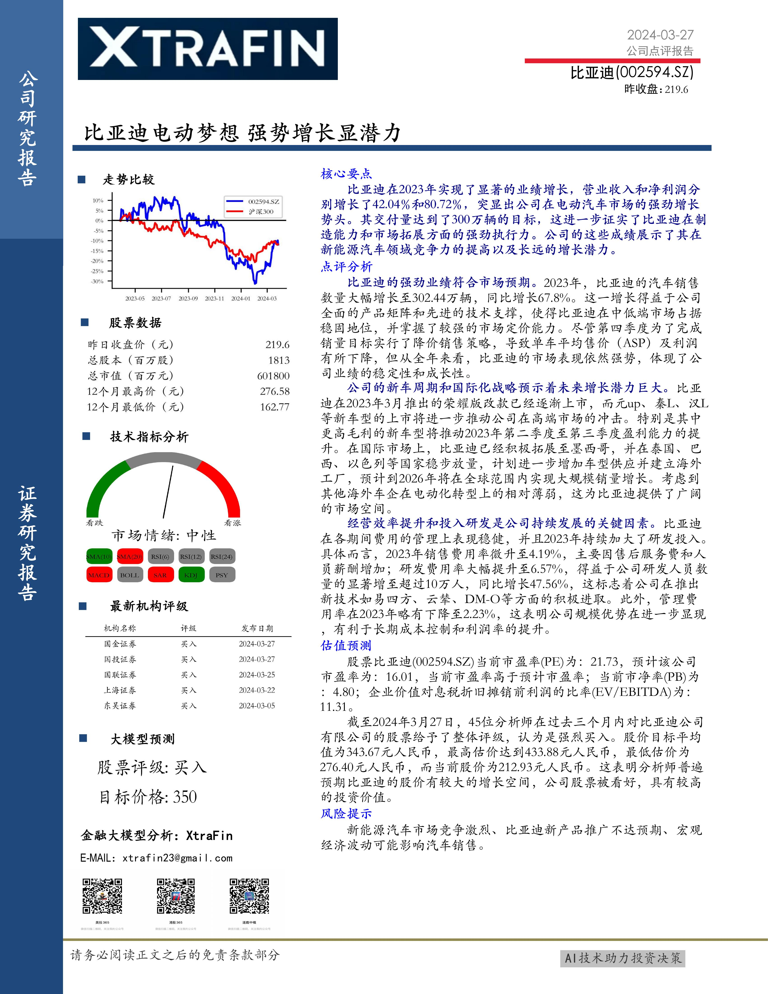
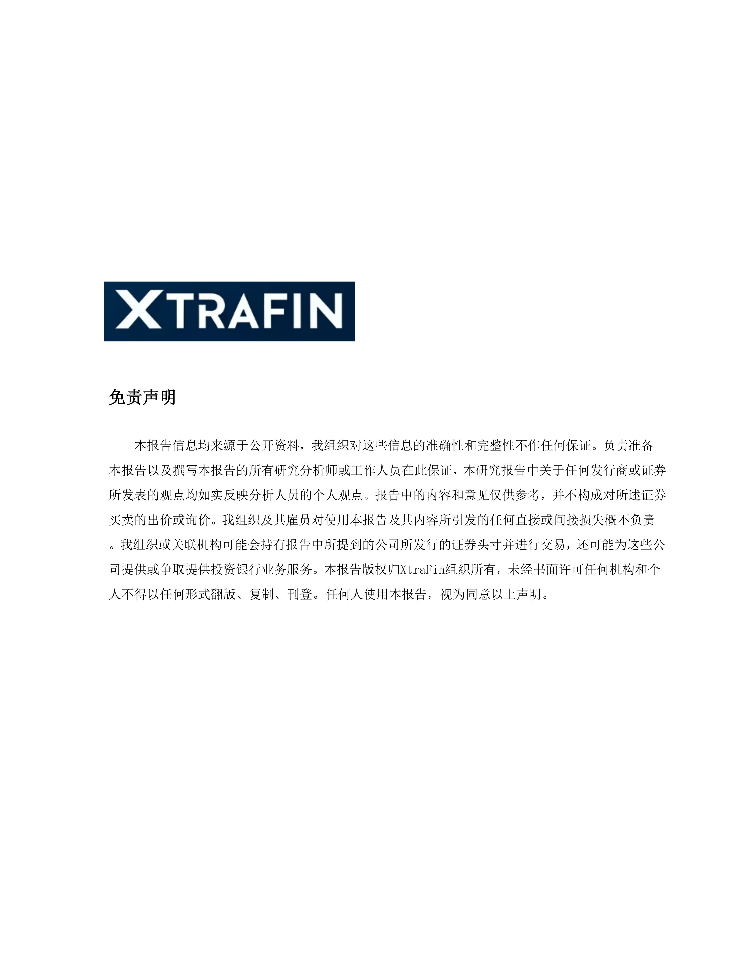

Slide 10
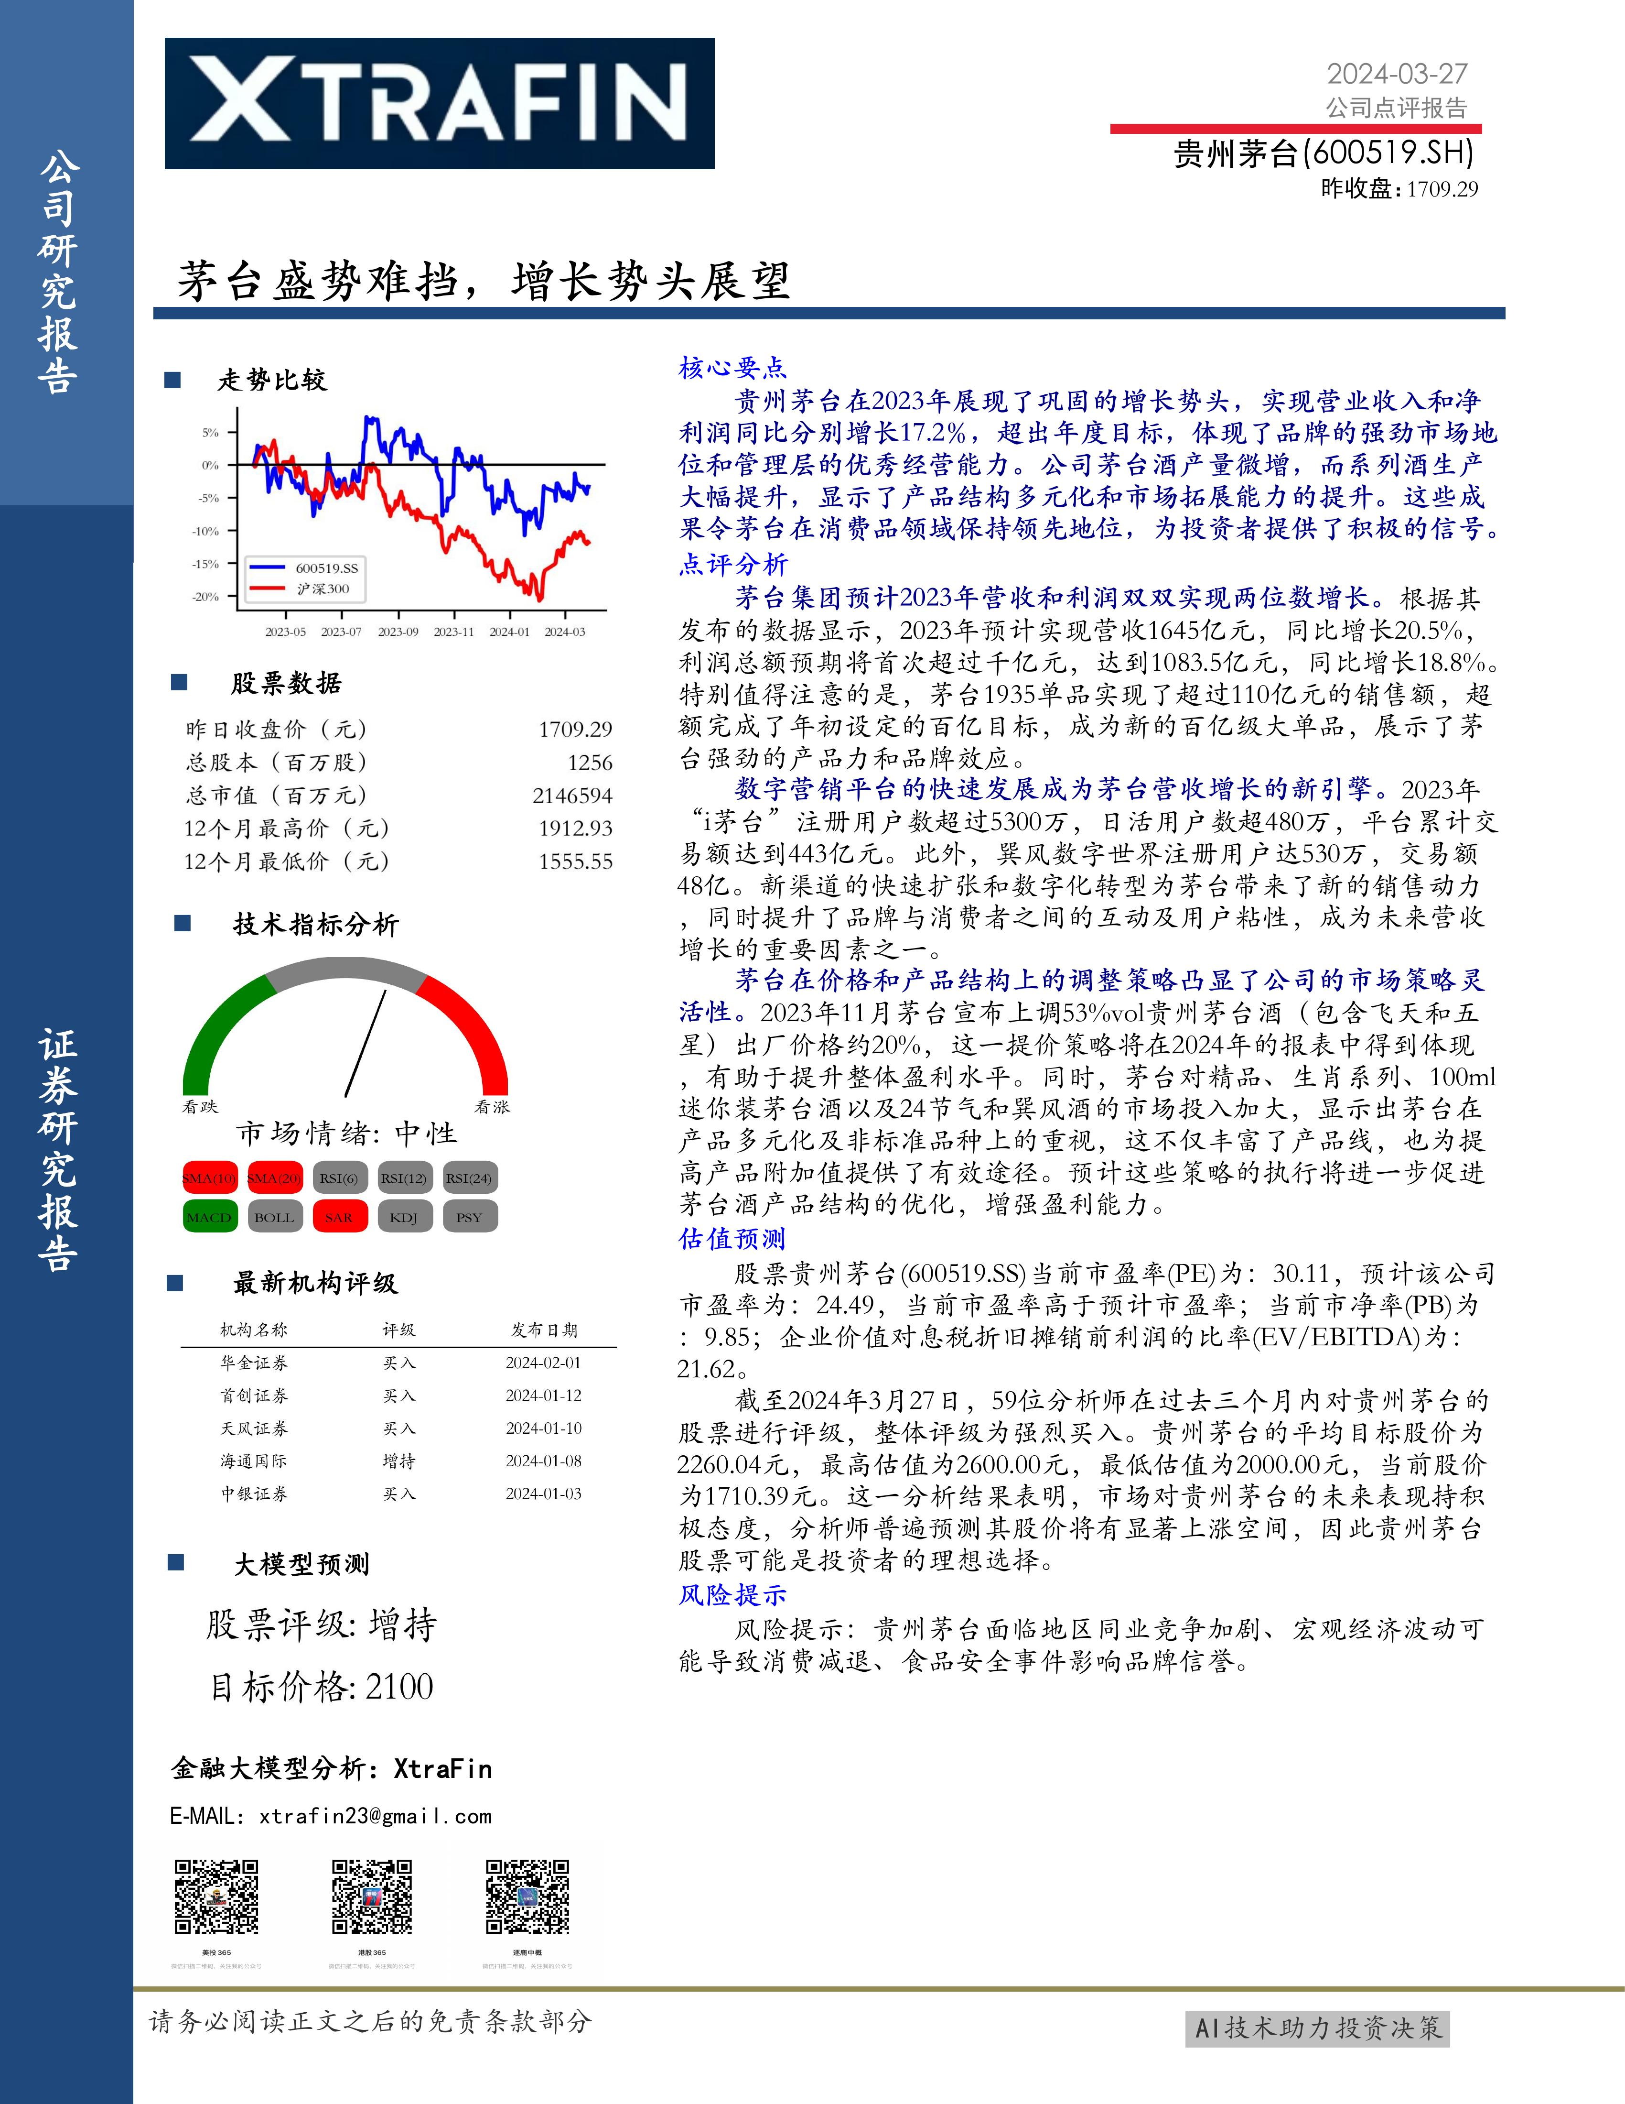

Slide 11
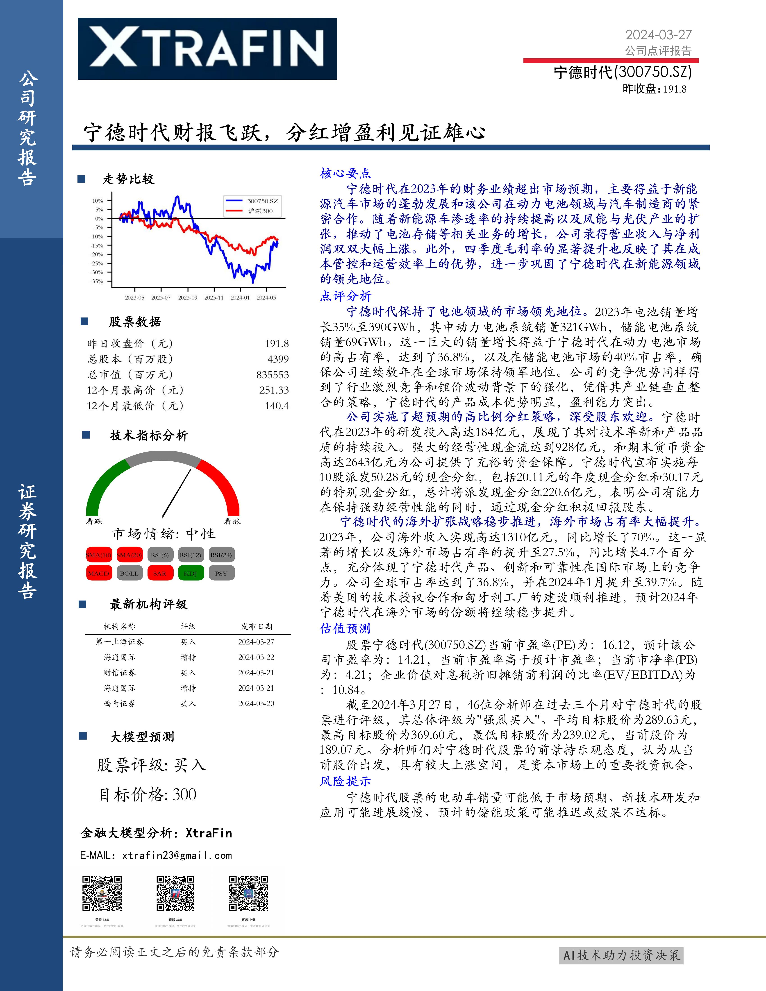

Slide 12
Our Website
https://bangbangday.com/zh/report-gen/
Test Account：
Email: test7@gmail.com
Password: WUDG461QiJx%ZuYLV9*aVmcW

Slide 13
In the future, we will...
Generate more detailed stock research reports
We are committed to providing deeper and more detailed stock analysis by continuously enriching our database and optimizing our technology and models, enabling investors to access a richer and more valuable set of information.
Expand to generate stock research reports for US and HK stocks
We will meet the diverse market demands and expand our service coverage to the US and HK stock markets, helping investors grasp international investment opportunities, making investment decisions more comprehensive and precise.

